Slide 1

Priory School are committed to providing for the spiritual, moral, social and cultural (SMSC) development of our pupils. Part of this commitment means that we actively promote the fundamental British Values. The fundamental British Values are defined as:
Democracy
The Rule of Law
Individual Liberty
Mutual Respect and Tolerance of Different Faiths and Beliefs
Promoting these British Values is a central part of teaching and learning. By doing this, we aim to help children become well-rounded members of society. These British Values are promoted throughout the curriculum, across the whole school. They are also seen in school ethos and policies, assemblies, special events and cultural celebrations.

Slide 2
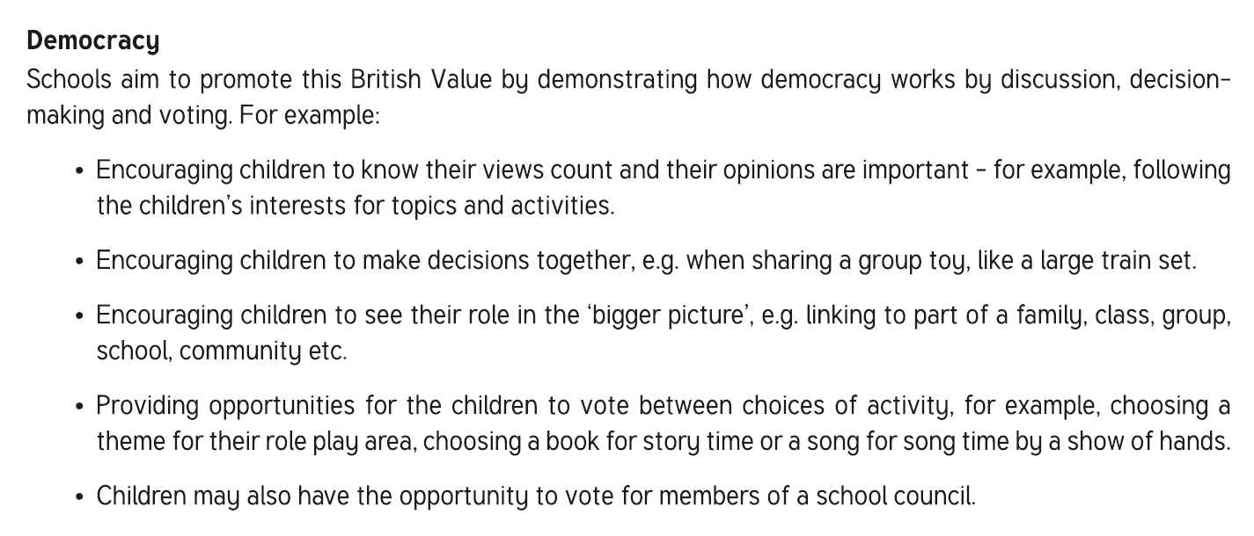

Slide 3
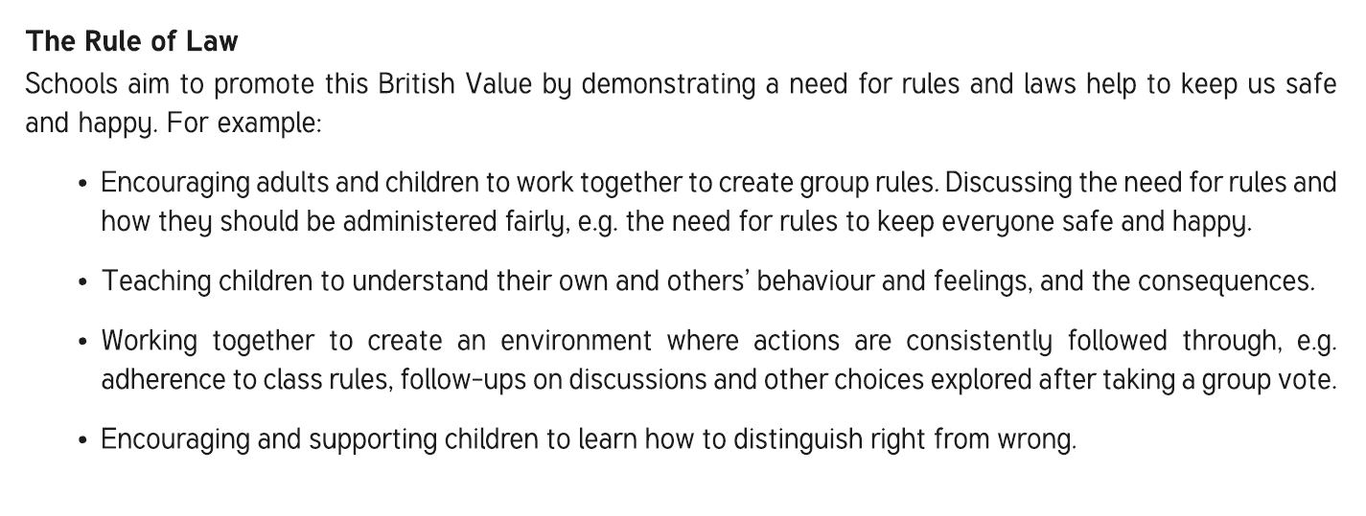

Slide 4
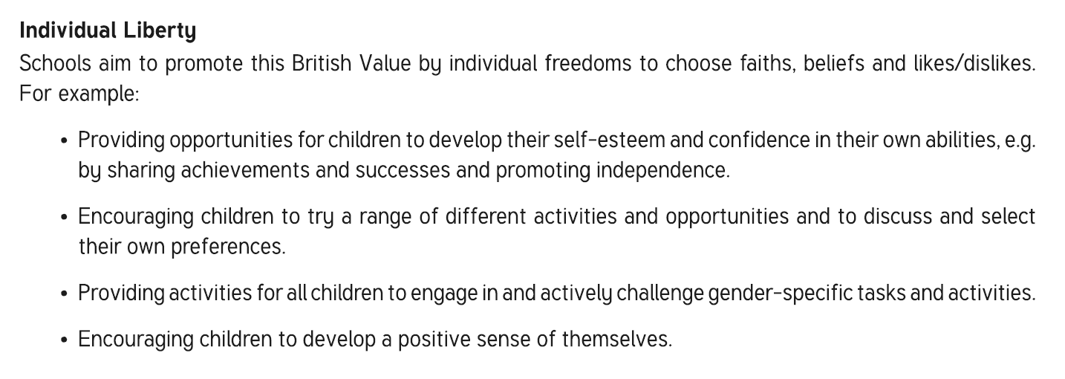

Slide 5
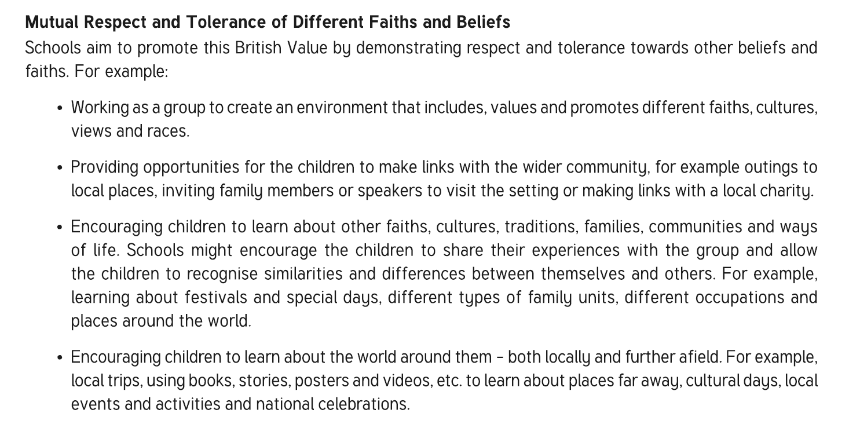

Slide 6

All members of staff and volunteers at Priory School:
Model the behaviours and attitudes that we want children to show
Challenge opinions or behaviours that are contrary to British Values

